Slide 1
DDLPS RWE Results Update
& Publication Plan (1403-0024)
Sherry Fu
2024 Apr 25

Slide 2



Background & Study Objectives
Background
DDLPS as a rare tumor, patient journey and outcomes is poorly understood
In the CTN for MDM2 DDLPS, China authority suggests BI collecting patients’ survival and other related clinical data in real-world, to provide support for future analysis during NDA
Study design
Study objectives
To characterize patients with DDLPS and describe clinical outcomes
Non-interventional study
Existing database established by NCC
Study period 2013 to 2021

Slide 3




DDLPS RWE Key Results
Cohort 1: 275 Patients initiating 1L
Demographics & clinical characteristics
  60% male, 80% initial diagnosis <65, 76% never smokers, 93% metastatic
  Surgeries before 1L: 1 (61%), 2 (20%), ≥3 (8%)
Survival
  OS from 1L: 13.4 (12.4-16.5)m
  OS from DDLPS diagnosis: 35.6m
Treatment
  Total line of treatment: 1 (52%), 2 (29%), ≥3 (19%)
  1L: anthracycline-based (44%), anlotinib-based (29%)
Healthcare resource utilization (HCRU, since 1L) per patient
  16 outpatient visits
  43 days of hospital stay
Direct medical cost
135 thousand Yuan per patient
Notes:
中美结果 一致，
Risk 比较低

Slide 4
DDLPS RWE Key Results (cont)
Cohort 2: 1115 Patients NOT initiating 1L
Demographics & clinical characteristics
  55% male, 72% initial diagnosis <65, 75% never smokers, 55% metastatic
  Surgeries before 1L: 1 (60%), 2 (27%), ≥3 (11%)
Survival
  OS from DDLPS diagnosis: 43.9m
HCRU since DDLPS diagnosis per patient
  9 outpatient visits
  44 days of hospital stay
Direct medical cost
133 thousand Yuan per patient

Slide 5
Insight from RWE
The 1st and largest DDLPS cohort in China, provides detailed clinical characteristics and survival outcomes for patients in real-world setting.
Demographics and OS from this study align with results from US study, which only included 51metastatic DDLPS patient.
DDLPS poses economic and HCRU burden due to need for specialist visits, repeated surgeries, in-clinic administration.
Beyond surgery, there are limited and suboptimal systemic therapies available. There is a high unmet need for an effective therapy indicated for advanced DDLPS.

Slide 6



1403-0024 DDLPS RWE Publication Plan & Timelines
CTOS
ESMO Asia
CSCO
13-16 Nov 2024, San Diego
Poster
6-8 Dec 2024, Singapore
Poster
25-29 Sep 2024, Xiamen
Oral presentation
Study Timelines
Proposal Approval
Protocol Approval
EC Approval
Site Contract
Conference Abstract submission
CSR
Results included in submission dossier
23 Jan ✔
23 May ✔
23 Nov ✔
24 Feb ✔
24 Jun
24 Aug
24 Nov

Slide 7
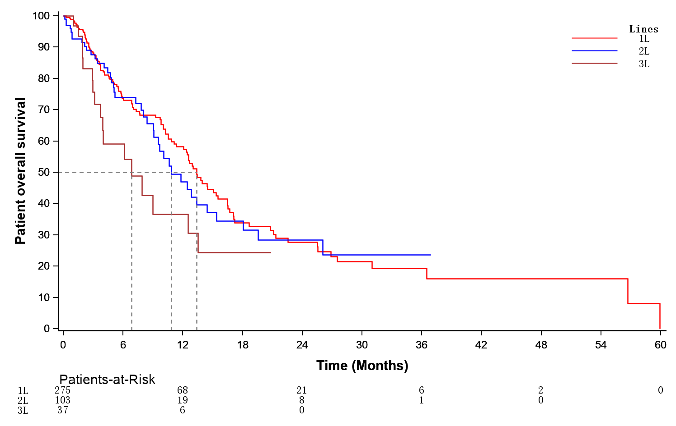


Primary endpoint: OS from the start day of each line of therapy
 | 1L (N=275) | 2L (N=103) | 3L (N=37)
OS from the start day of each LOT, months (95% CI)
KM median | 13.4 (12.35-16.49) | 10.8 (9.07-18.07) | 6.8 (3.94-NE)
Survival rate, % (95% CI)
At 6 months | 73.65 (67.92-79.86) | 73.98 (64.55-84.78) | 59.13 (42.94-81.43)
At 12 months | 58.20 (51.17-66.21) | 47.02 (35.01-63.14) | 36.59 (20.52-65.23)
At 18 months | 33.84 (26.25-43.63) | 34.47 (23.05-51.55) | 24.39 (10.86-54.77)
At 24 months | 27.63 (20.25-37.69) | 28.43 (17.53-46.11) | NE
At 36 months | 19.28 (12.29-30.23) | 23.70 (12.98-43.24) | NE
US metastatic DDLPS :
1L OS 12.6 (8.6-19.8) months (N=51)
2L OS 9.8 (6.5-46.6) months (N=32)
OS from the start day of each LOT, months (95% CI)* | 1L N=275 | 2L N=104 | 3L N=36
KM median | 13.4 (12.4-16.5) | 10.8 (9.1-18.1) | 7.9 (3.9-NE)
* 死亡数据截至2021年12月31日，待更新至2022年12月31日

